Slide 1
Lesson 1
The atom

Slide 2
Atomic particles
Atoms can be modelled as a nucleus, surrounded by electrons in distinct energy levels, held together by electrostatic forces of attraction between the nucleus and electrons; the location of electrons within atoms can be represented using electron configurations
Atomic particles:
An atom contains three subatomic particles- the proton, the neutron, and the electron.
Symbols, charge and masses of atomic particles
https://www.youtube.com/watch?v=FSyAehMdpyI&list=PL8dPuuaLjXtPHzzYuWy6fYEaX9mQQ8oGr&index=1
Particle | Symbol | Charge | Relative mass
Proton | p | +1 | 1
Neutron | n | 0 | 1
Electron | e | −1 | 1/1800 (approx.)

Slide 3
The nucleus of an atom is a very small region of space that contains all the protons and neutrons. The nucleus contains most of the atom, but occupies only a small volume of the atom. Surrounding the nucleus are the electrons.
Electrons are very small, move extremely fast, and are spread out over a relatively large distance. This creates an electron cloud around the nucleus.

Slide 4
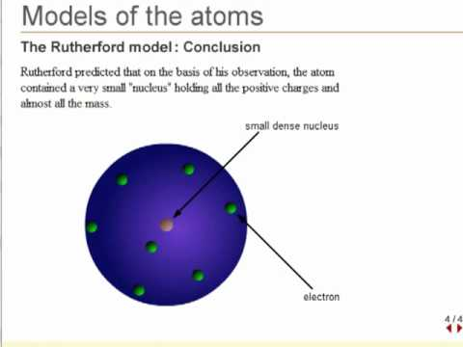
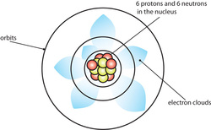

Slide 5
The current model of the atom was initially theorised by Ernest Rutherford in the early 1900s after an experiment in which he fired alpha particles at a thin sheet of gold foil.
Earlier models of the atom suggested that all the particles would be evenly spread throughout the atom. It was thus expected that the alpha particles would pass through the gold foil with little or no deflection.
Rutherford found that a small number of the alpha particles experienced a significant deflection as though they had struck something large. This did not support his hypothesis and led to Rutherford theorising that most of the atom was in a structure in the centre. This structure is the nucleus, which contains all the protons and neutrons.

Slide 6
The composition of elements can be represented by
^{A --------------} Mass number ( total number of protons+ neutrons)
X ------------ Symbol of element (depends on the value of Z )
_{Z ---------------} Atomic number ( number of protons)
The atomic number, ‘Z’ represents the number of protons in the atom. For an uncharged atom the number of electrons and protons are equal, so the atomic number will also give the number of electrons in the atom.

Slide 7
On a periodic table, the atomic number is the smaller number inside the box, often located above the element symbol.
The mass number, A is the total number of protons & neutrons in the atom.
Number of neutrons = mass number− atomic number
On a periodic table, the mass number is the larger number inside the box and may not be a whole number. When using mass number to calculate the number of neutrons, round it to the nearest whole number.

Slide 8
Answer the following questions
Determine the number of protons, neutrons and electrons of:
A) ³⁵Cl₁₇ B) ²⁷Al₁₃
Use the correct atomic representation to write the element:
A) zinc, which has 30 protons and 35 neutrons
B) lead, which has a mass number of 207 and 82 protons

Slide 9
What holds an atom together?
An atom can be modelled as a nucleus surrounded by electrons, held together by electrostatic forces of attraction between the nucleus and electrons.
How a nucleus stays together?
The nucleus of an atom is very stable despite being composed only of positive protons and neutral neutrons.
Electrostatic repulsion is a force that occurs between particles with the same charge. Repulsive forces act between protons in the nucleus.
Another type of force is present in the nucleus, called the strong nuclear force. It occurs between all particles in the nucleus, regardless of charge.

Slide 10
This force is attractive, so there is attraction between neutrons and neutrons, neutrons and protons and even protons & protons. The force is also short range- only works between particles that are very close to each other.
In a stable nucleus, the electrostatic repulsive forces and the short-range attractive nuclear forces are balanced. If the forces are unbalanced, then the nucleus will be unstable and decay over time.
Look at Figure C1.4 (a and b) in the following slide.

Slide 11
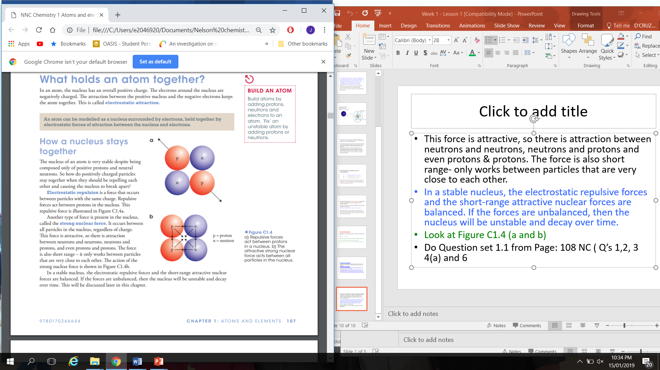

Slide 12
Questions
1. Name the three particles in an atom and state the charge of each particle.
2. Describe where each of the three particles is found in the atom.
3. Explain the balance of forces that exists in a nucleus that makes it stable.
4. Name the following element and calculate the number of protons, neutrons and electrons.
19
Br
35

Slide 13
Isotopes
Isotopes of an element have the same electron configuration and possess similar chemical properties but have different physical properties
Isotopes are atoms of an element with the same number of protons but different number of neutrons.
E.g. 12 14
₆^{C and} ₆ ^{C}

Slide 14
Isotopes of the same element will have very similar chemical properties. When an atom reacts in a chemical reaction, its behaviour is due to the arrangement and number of electrons.
Isotopes have the same number and arrangement of electrons so their chemical properties are similar.

Slide 15
Isotopes of the same element can have different physical properties. These properties are features like colour, density and mass that you can observe or measure.
Properties can vary because isotopes have slightly different masses due to the different numbers of neutrons.

Slide 16
Stable and unstable isotopes
Some isotopes of elements are stable because the attractive and repulsive forces in the nucleus are balanced. Other isotopes have unstable nuclei in which the forces are not balanced.
Some nuclei, the attractive forces are stronger than the repulsive forces. In other nuclei repulsive forces are stronger than attractive forces. In both of the cases where forces are not balanced, an unstable nucleus forms and the nucleus will undergo radioactive decay to become stable.

Slide 17
Relative atomic mass
An atom is extremely small, so it is difficult to measure the mass of one atom. We use relative atomic mass A_{r}, which compares the mass of an atom to the mass of another atom.
Atom’s mass shown in the periodic table is not an actual measured mass. However, a comparison that have been developed by scientists.

Slide 18
Scientists arbitrarily picked carbon-12 as the standard for comparison to calculate relative atomic mass because carbon was selected for ease of use in experiments and it is a very common element on Earth.
The relative atomic mass of an atom is the mass of the atom relative to the mass of a carbon-12 atom. The mass of a carbon atom is considered to be exactly 12 and all others are compared to this.

Slide 19
Magnesium has twice the mass of carbon so has a mass of 2X 12= 24
Three helium atoms have the same mass as one carbon atom. Therefore relative atomic mass of helium is 1/3X 12= 4

Slide 20
Isotopes of the same element have different atomic masses. They also have different abundances on Earth, means they are found in different amounts.
E.g. two of carbon’s isotopes are carbon-12 and carbon-13. On Earth, 98.9% of all carbon is carbon-12 and 1.1% of carbon-13. Other isotope of carbon, such as carbon-14, is present in very low levels.

Slide 21
The mass and abundance of naturally occurring isotopes of an element are used to calculate the mass numbers shown in the periodic table.
For the two isotopes of carbon, the equation is:
Mass number= ( abundance percentage x atomic mass) + ( abundance percentage X atomic mass)
100

Slide 22
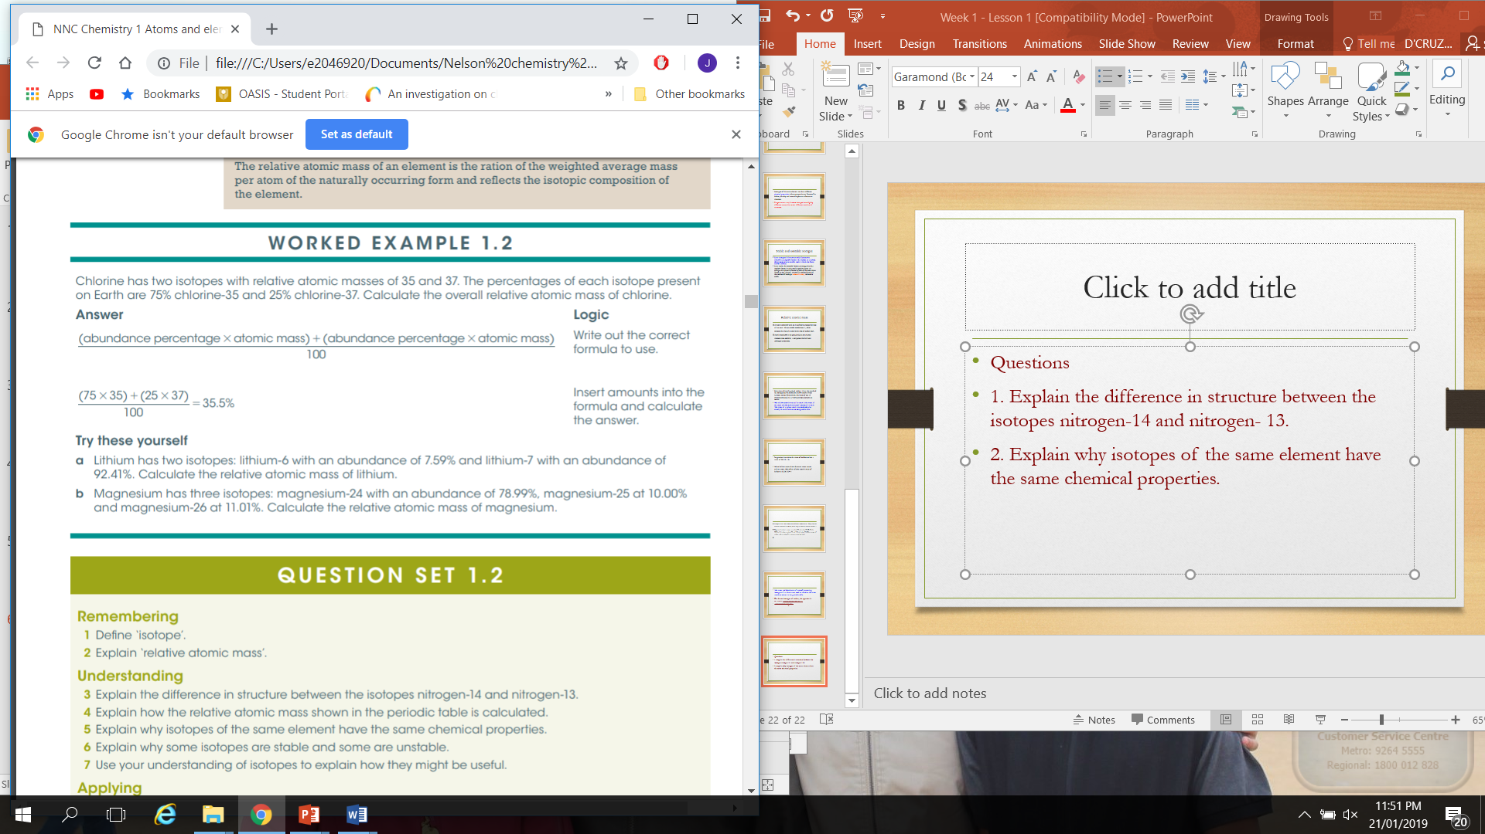

Slide 23
Questions
1. Explain the difference in structure between the isotopes nitrogen-14 and nitrogen- 13.
2. Explain why isotopes of the same element have the same chemical properties.

